Slide 1
Compilation Techniques (5)
Recursive Descent Parsing
Errors handling
Common prefixes
Left recursion
Syntactic and semantic predicates
Predictive parsing
© Codruta-Mihaela ISTIN 2015

Slide 2
Recursive Descent Parsing (RDP)
A top-down parsing algorithm in which every production is implemented as a function
It is easy to implement by hand so it used in many manually written parsers
It offers a lot of flexibility and many features can be implemented (such as syntactic and semantic predicates), features which are not available using the stricter notation of finite automata
For most of the programming languages grammars RDP can be made to run in almost the same time as a bottom-up algorithm
© Codruta-Mihaela ISTIN 2015

Slide 3
RDP algorithm (1)
In the tokens list we consider a current token, initially the first one
Each nonterminal is implemented as a function (predicate) which returns:
  true – if the tokens starting with the current token matches that nonterminal. In this case the current token is also advanced to the position after all matched tokens (the predicate consumes all the tokens matched by its production).
  false – if the tokens do not match the nonterminal. In this case the current token position must remain unchanged.
The terminals (tokens) are tested by a function consume(code) which receives as argument a token code. If the current token has the same code it is consumed and the function returns true. Else, the position remains unchanged and the function returns false.
RDP is started with the start nonterminal
© Codruta-Mihaela ISTIN 2015

Slide 4
RDP algorithm (2)
If a member of a production is:
  token (terminal) – it is tested (and automatically consumed if a match) with the function consume
  nonterminal – it is tested (and automatically consumed if a match) by calling its own predicate
Any production can be completely consumed by combining the use of the function consume for tokens with predicates calls for nonterminals
If a production is only partially consumed, it means that it cannot be fully matched. In this case the current position must remain unchanged and the predicate returns false. In order to be able to reset the partially advanced position to the start position (the one which was at the beginning of the predicate), the start position can be first saved and then restored.
© Codruta-Mihaela ISTIN 2015

Slide 5
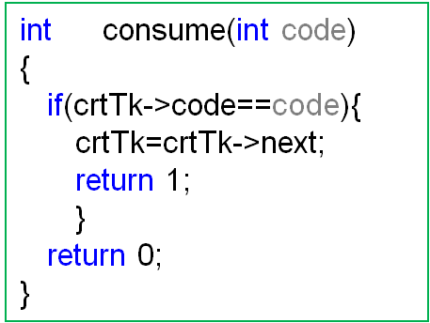
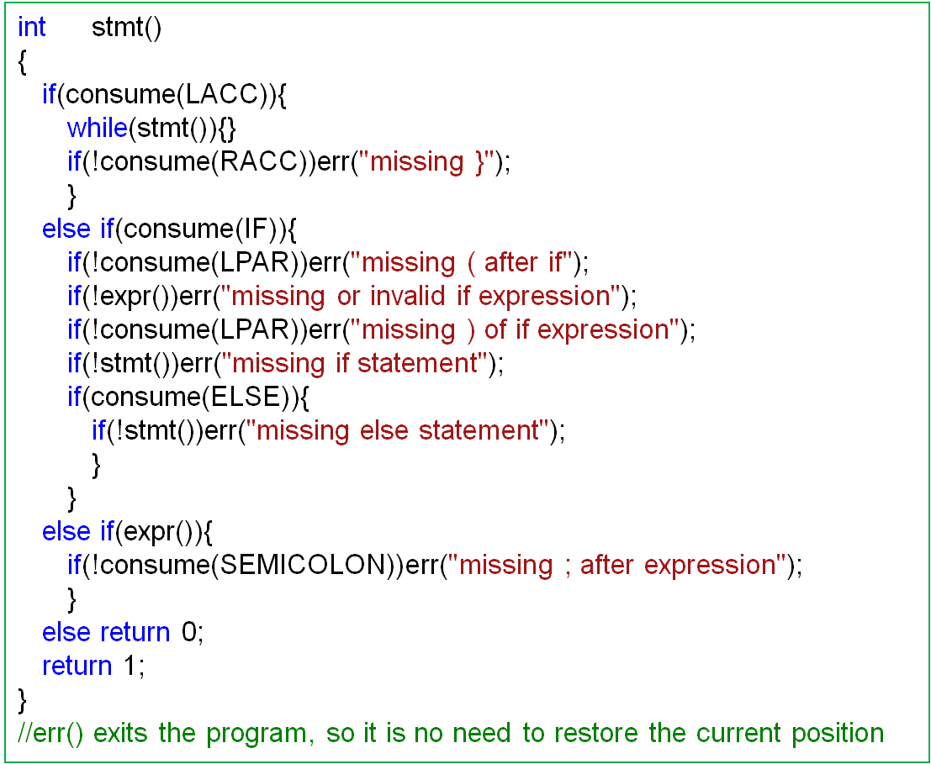
An example
stmt ::= LACC stmt* RACC
| IF LPAR expr RPAR stmt ( ELSE stmt )?
| expr SEMICOLON
© Codruta-Mihaela ISTIN 2015

Slide 6
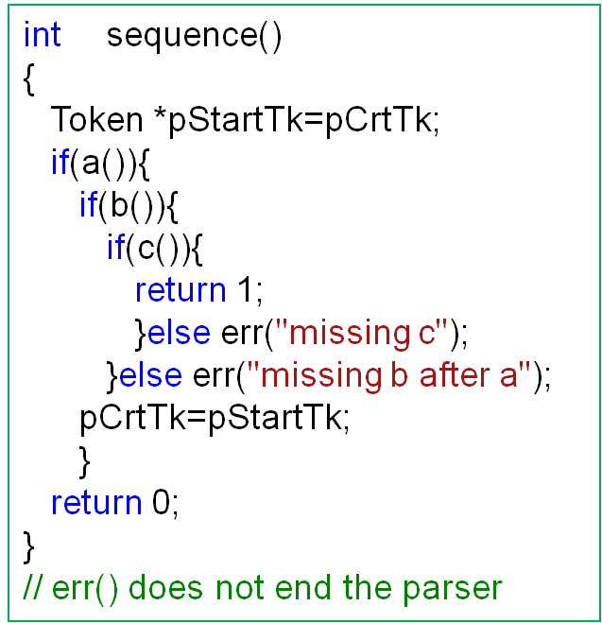
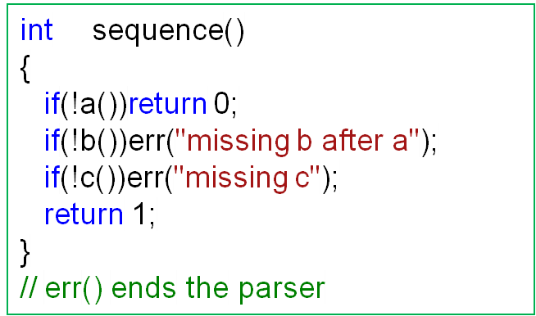
Sequence ( a b c … )
It is implemented with nested ifs, because in order to consume a sequence all its members must be consumed
© Codruta-Mihaela ISTIN 2015

Slide 7
Errors vs return false
If a rule does not match, when to throw an error and when to return false?
return false – in all cases when another alternative or rule can still be matched (ex: if a statement can be “for”, “if”, “while”, …, the non-matching of a “for” will not throw an error because other statements can still match)
throw an error – in all cases when we are sure that other alternatives or rules cannot match ( ex: missing ( after a “for” )
The sequences allow precise error messages, because in many cases only one token/nonterminal must follow and its absence can be signaled
Attention: sometimes the absence of a nonterminal does not mean a real absence but an error within it (ex: “if(a+<2)” )
The alternatives can compose their error messages from all the alternative possibilities or throw more generic messages, like “syntax error”
© Codruta-Mihaela ISTIN 2015

Slide 8
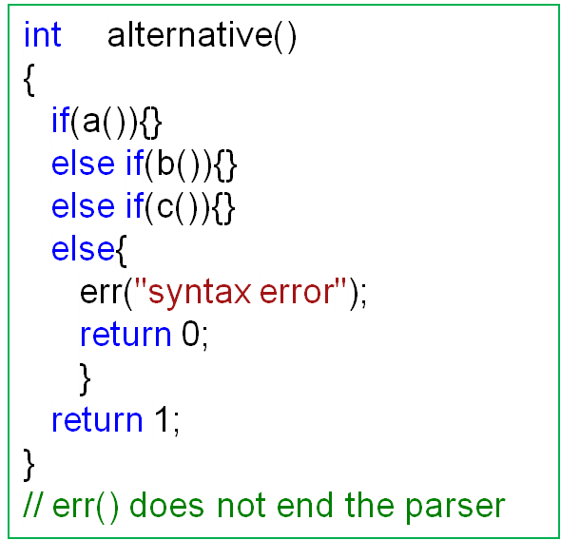
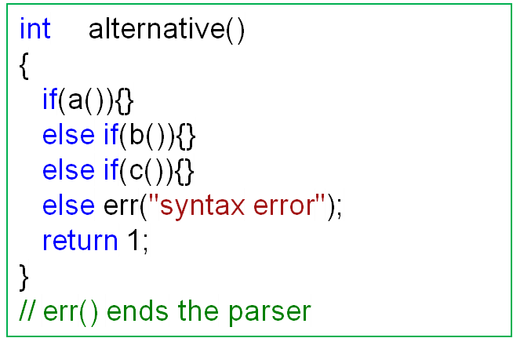
Alternative ( a | b | c … )
It is implemented with a series of “if…else if…else if…else”, because the rule is consumed if any component is consumed
© Codruta-Mihaela ISTIN 2015

Slide 9
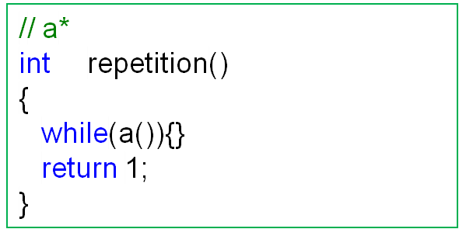
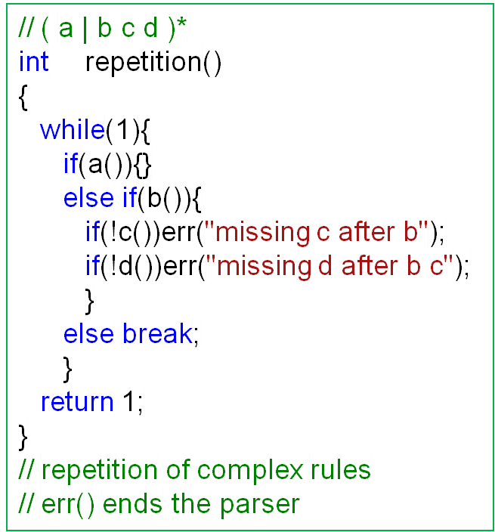
Optional repetition ( a* )
It is implemented with a “while” and the actual repetition count is not tested, because it does not matter
a+ = a a*
© Codruta-Mihaela ISTIN 2015

Slide 10
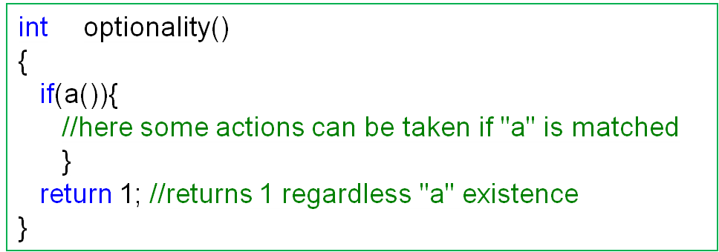
Optionality ( a? )
It is implemented without taking the result into account, because it is optional
The result can be taken into account if some actions depend on its presence (ex: “else” is optional, but if it exists it must generate some code)
© Codruta-Mihaela ISTIN 2015

Slide 11
Alternatives and rules with common prefixes
A ::= α β₁ | … | α β_{n}
If an alternative has components with the same prefix (α), this prefix must be factorized:
A ::= α ( β₁ | … | β_{n} )
If the prefix had not been factorized, the sequence “α β₂” would be tested on the path “α β₁” (because of α) where it fails, so the entire alternative fails
If different rules have the same prefix on one or more of their components (R₁ ::= α β₁ ; R₂ ::= α β₂ ) and if these rules are called as components of the same alternative ( R ::= R₁ | R₂ ), any of the following approaches can be taken:
  The common prefix can be extracted from each rule and it can be factorized
  After each failed test ( R₁ or R₂ ) the current token is reset and the next possible alternative is tested
TURN LEFT e | TURN RIGHT e → TURN ( LEFT e | RIGHT e )
© Codruta-Mihaela ISTIN 2015

Slide 12
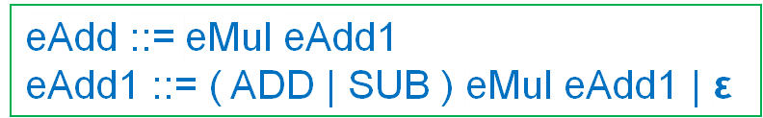
Rules with left recursion
A ::= A α₁ | … | A α_{m} | β₁ | … | β_{n}
If a rule appears as prefix on one or more of its components (left recursion), it must be transformed as:
A ::= β₁ A’ | … | β_{n} A’
A’ ::= α₁ A’ | … | α_{m} A’ | ε
A’ is a name not yet used
ε (eps, epsilon) – is the empty rule, which is always matched. ε in an alternative makes the entire alternative optional: α | ε = α?
If the rule had not been transformed, its code would start with “int A(){ if(A()){…}…”. In this case the first action inside “A()” would be a call to itself without any token consumed, which would end in an infinite recursion
eAdd ::= eAdd ( ADD | SUB ) eMul | eMul
© Codruta-Mihaela ISTIN 2015

Slide 13
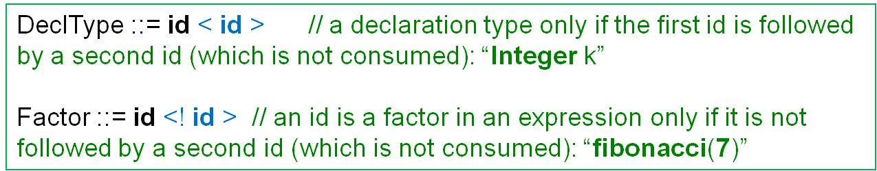
Syntactic predicates
CFG parts which are not consumed but must be matched in order to match the production
A syntactic predicate can test the presence or the absence of a CFG part
There is no standard notation for syntactic predicates, so different tools have different notations
After a syntactic predicate is tested, the current token is reset on its first token, so its tokens are not consumed
© Codruta-Mihaela ISTIN 2015

Slide 14
Semantic predicates
Tests which are expressed directly in code because they cannot be expressed using CFG constructs (the decision is semantic, not syntactic)
The expression “(Integer)(k)” can be parsed as:
  cast of “k” to an “Integer” value
  call of the function “Integer” with “k” as argument
The decision between these two alternatives cannot be taken from the syntax alone, so the decision must be made by taking into consideration other factors, for example a symbols table which tells if “Integer” is a type or a function. This test will be implemented directly in code.
Cast ::= ( id ) E
E ::= E ( Args ) | id | ( E ) | Cast
Args ::= Args , E | E | ε
© Codruta-Mihaela ISTIN 2015

Slide 15
Predictive RDP
In grammars with many alternatives there can be a lot of trial and backtracking because the alternatives are implemented with a series of “if…else if…else if…else”, so in the worst case all components are tested
Many of these tests can be eliminated if for each alternative we compute a set named FIRST(α), which contains all possible tokens which can start “α”. This means a lookahead of 1.
For the alternative “α | β” let FIRST(α)={T₁,T₃} and FIRST(β)={T₂,T₃}
In the above case, if the next token is:
  T₁ – only the α component can be matched
  T₂ – only the β component can be matched
  T₃ – both α and β components can be matched. In this case further tests are necessary to take the correct decision (for example by increasing the lookahead)
Example: the correct choice of “stmt ::= For | While | Return | If | expr ;” can be predicted with a lookahead of 1 (the FIRST function)
© Codruta-Mihaela ISTIN 2015

Slide 16
Bibliography reading
Compilers. Principles, Techniques and Tools
4.3, 4.4
© Codruta-Mihaela ISTIN 2015

